Slide 1
Capstone Final Project- Macroeconomic Forecasting
By Jonathan Rius
11/23/2023

Slide 2
Introduction
The following is a study of macroeconomic data and using machine learning for economic forecasting.
Basically the project aims to explore macro economic data and make use of machine learning for forecasting with arima. Other models will be used to possibly make predictions. EDA will be applied as well.
Why does it matter? Forecasting and data exploration could be useful in making policy changes. Often times policy changes make a significant impact on macroeconomic indicators.
What are your research questions? What will inflation, GDP, unemployment rate and the federal interest look like in the future? Can indicators predict the other? What are some correlations between economic indicators, and what are some trends that occur when looking at the data, what is the frequency of most of the data?
Basically the project wishes to explore trends, look at where most of the data is concentrated, make forecasts using arima, and perform models with variables that have strong correlations.

Slide 3
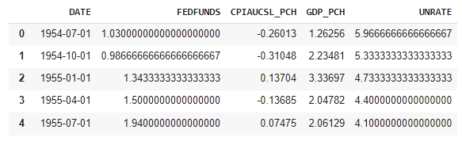
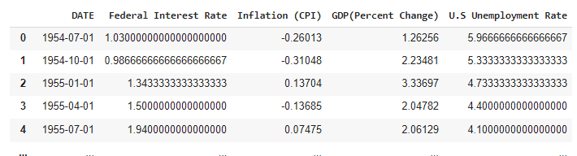
Final Dataframe and Preprocessing Data
The dataset was four csv files that were combined. Afterwards columns were renamed and data types were changed to allow for data exploration.

Slide 4
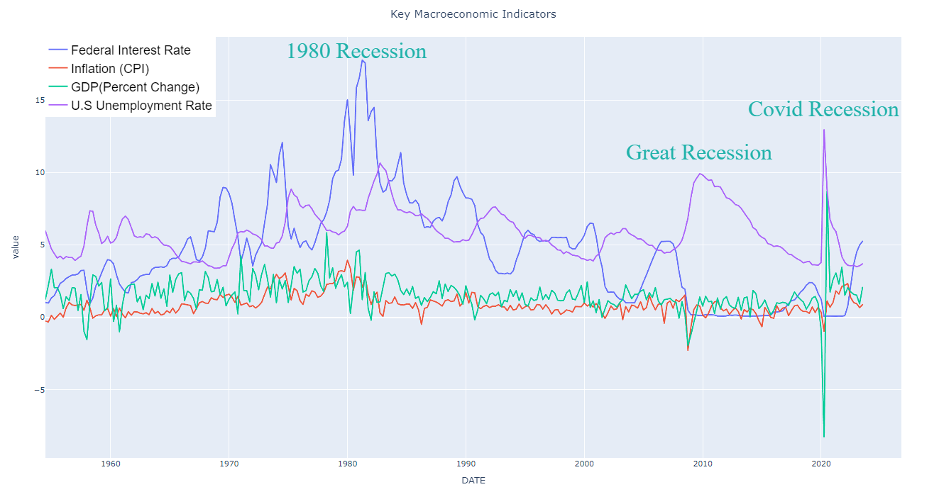
Explorating Trends and Key Events using plotly
A simple line graph is used to explore trends, annotations were made to explore the effect recessions had on indicators. As you can see gdp and unemployment were most affected by recessions. Sometimes the interest rate was effected, and inflation remained relatively stable.

Slide 5
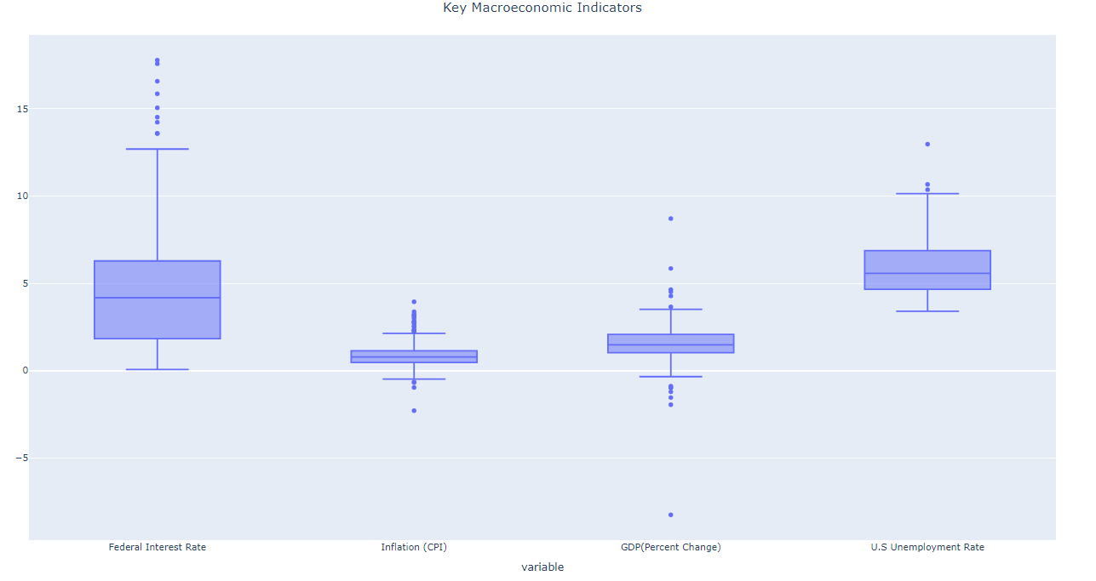
Exploring frequency using Box plot graphs
Interest rate had the highest range of numbers, and inflation had the least. Values typically ranged from 0 to 5 except for unemployment which had values more concentrated between 5 and 10.

Slide 6
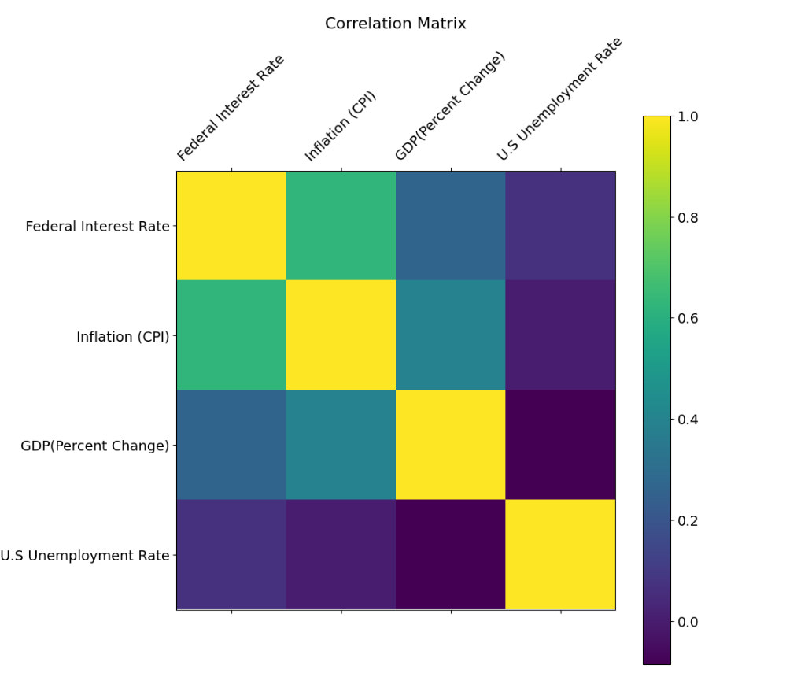
Correlation and correlation matrix with indicators
Not a lot of notable correlations. Since inflation rate and interest rate has the highest correlation regression analysis will be run. In reality, the fed will increase interest rates when inflation is too high or low so this makes sense. GDP and inflation correlation also occurs in nature, but this shows a relatively moderate one.

Slide 7
Arima Models and Other Predictive Models
ARIMA Model for Time Series Forecasting
ARIMA stands for autoregressive integrated moving average model and is specified by three order parameters: (p, d, q).
Because there is a correlation between interest rate and inflation( the Fed will often raises interest rate to slow inflation) predictive models such as linear regression, random forest, and extra tree will be used.

Slide 8
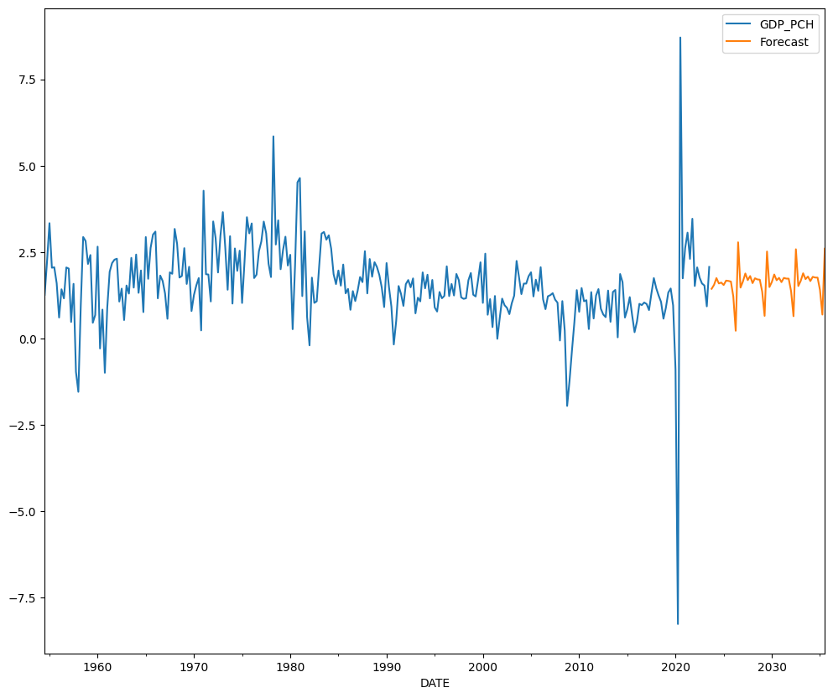
GDP: Forecast using ARIMA Model
The model has a means squared error of 2.22 which is pretty low and the forecast is realistic if no recessions occur. While the model does not take into account those recessions, the forecast of the percent change going between 0 and 2.5 is a realistic one. This combined with a low MSE means its a decent model.

Slide 9
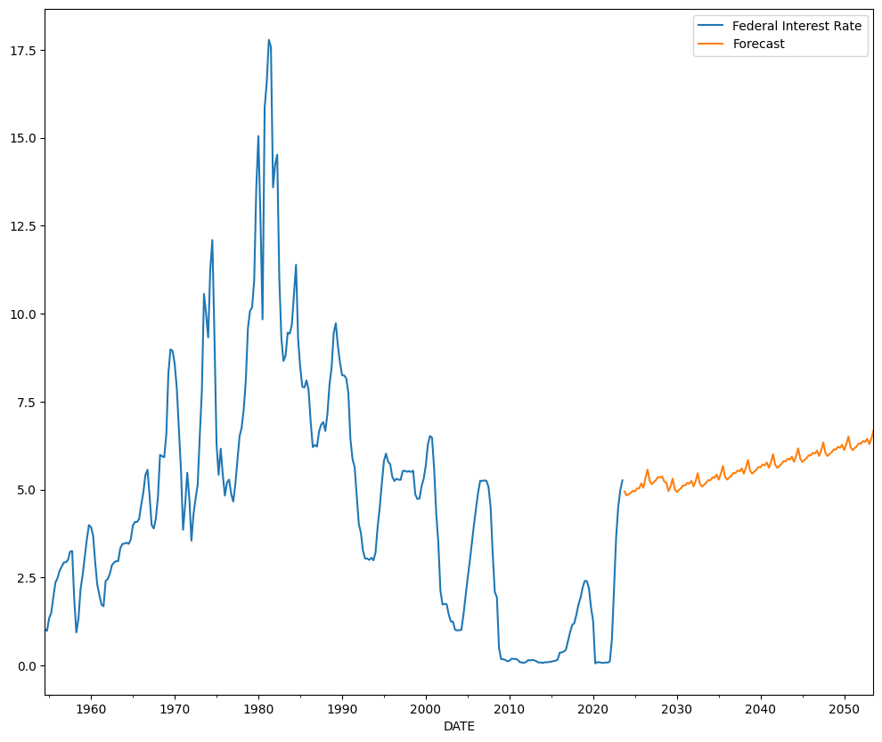
Federal Interest Rate: Forecast using ARIMA Model
This means squared error is almost 8 and the model is somewhat unrealistic. In a nature setting the interest rate changes according the economic landscape to induce or slow down borrowing. This model shows an increase of the interest rate over many years and this just not economically feasible.

Slide 10
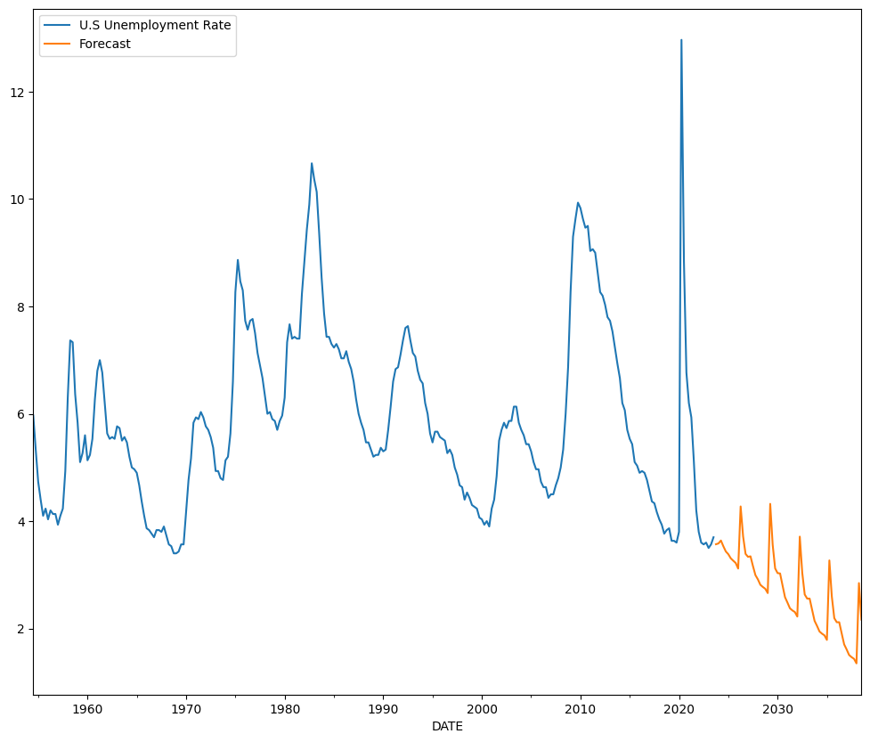
U.S Unemployment Rate: Forecast using ARIMA Model
This has a high means squared error of 24, the model is also highly questionable, if continued past ten years the unemployment is in the negatives. This is impossible. The unemployment rate changes greatly to economic contacting and recession like events.

Slide 11
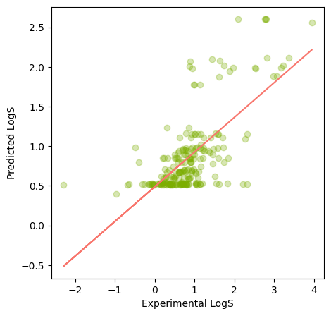
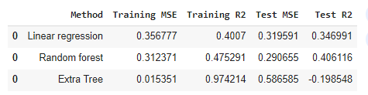
Predictive models and Regression analysis
To put it briefly there was a correlation between the interest rate and inflation, a model was produced. The model has R2 of .47, so the model is adequate but not strong enough for the interest rate to predict the target variable of inflation.

Slide 12
CONCLUSIONS
Let’s split the conclusion into several categories.
Trends: Basic exploratory analysis reveals that recessions cause certain indicators to fluctuate and data going high or low is a result of outside economic forces.
Frequency: Indicators showed most data was concentrated between values zero and five, except for unemployment rate. Inflation had the shortest range and interest rate had the highest range (thats because its easier to change).
Correlations: Only one correlation (inflation vs interest rate) was above .5. In many economic situations the interest rate is used to control inflation. It was as a predictor variable for regression analysis.
Arima modeling: All models besides the gdp will unrealistic, the gdp is the only plausible scenario (if recessions occur).
Regression analysis: With interest rate as the predictor variable and the inflation as the target variable, the model’s R2 score was too low to be considered good. Therefore the interest rate does not necessarily predict inflation.

